Slide 1
Internal Development Schedule – 6 months
AGENDA
Work environment and revenue challenges
Current workload and follow-up issues
Plans for next 6 months

Slide 2
Social Network Gaming System (SNGS)
Social Network Gaming System (SNGS) is a peer-to-peer online game played in virtual halls. The gameplay mechanics requires multiplayer participation and the outcome is based on some level of skill abilities of the players.
The first cross-platform "Facebook-to-Mobile" social-network game was developed in 2011 by a Finnish company Star Arcade.
Social-network games are amongst the most popular games played in the world, with several products with tens of millions of players. (Lil) Green Patch, Happy Farm,Farm Town, YoVille and Mob Wars were some of the first successful games of this genre.
FarmVille, Mafia Wars, FrontierVille, CityVille, Gardens of Time, Kantai Collection and The Sims Social are more recent examples of popular social-network games.
Major companies that made or published social-network games include Zynga, Wooga, Bigpoint Games, Gameforge, Goodgame Studios, MegaZebra,
5 Minutes, Playfish, Plinga, Playdom, Kabam, Crowdstar, RockYou and Booyah.
Tradinally social games have some level of free play and normally players do not win cash prizes.
Social games require certain level of skill in order to win and there are sometimes referred to as Skill-based games. These are can have cash prizes as well. These are very popular in India.
Number of regulatory jurisdictions have published their own definition of a skill based games.
If the system is certified to these standards then it can give out cash prizes subject to appropriate regulatory approvals and licenses.
One such skill-based game definition is published by AGCO.

Slide 3

Gaming Portal
Loxley International Foundation

Slide 4


Landing Page
Loyalty Points
Skill Points
Sign Up
Login
General Information 1
Game List
Cash Reward Leaderboard
Hall # | Type of game | Group | Game Name | Date & Time | Entry Fee
1 | Trivia | Movies | Game # 1 | 02/06/2020 - 19:30 | 25
2 | Survey | Misc. | Game 2 | 02/06/2020-19:30 | 50
3 | Trivia | Sports | Game # 3 | 02/03/2020–18:00 | 100
General Information 2
Skills Leaderboard
Game List search options
Type of games
Game Group
Entry Fee
Winners List
Hall # | Game Name | Winner
Third Party Games
Loyalty Leaderboard
Loxley International Foundation
About Us
T & C
How to Play
Privacy Policy

Slide 5
Leaderboard Definition
Cash Reward Leaderboard
Frequency Weekly
# of correct answers. 1 point for each correct answer.
Skills Leaderboard
Frequency - Monthly
# of correct answers + # of game participated.– 1 point for each correct answer and 2 points for each game participated.
Loyalty Leaderboard
Frequency - Yearly
Total amount spent on placing bets.– Sum of total spend on games.
Loxley International Foundation

Slide 6
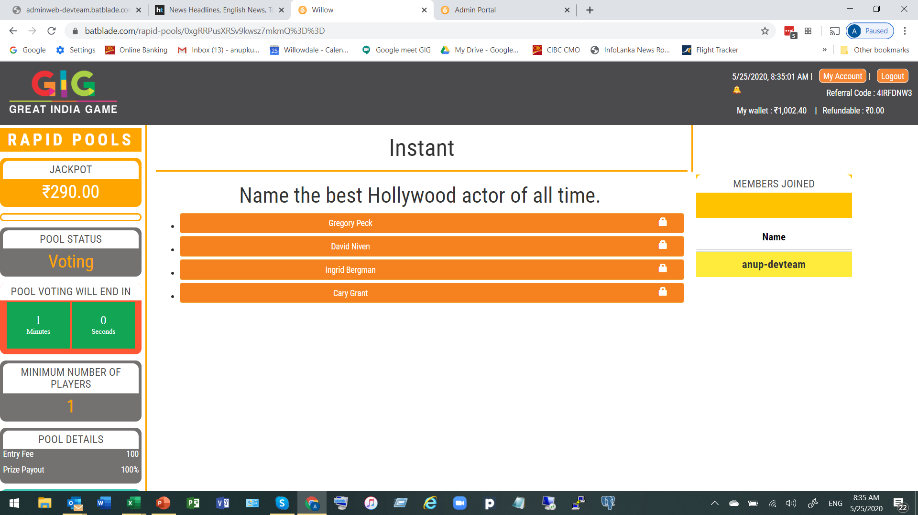
Virtual Hall Game Page
Loyalty Points
Skill Points
Name
Balance
Game Information
Game Play Area
Players Joined
Interactive Chat Relay (IRC)
Enter Chat
Loxley International Foundation
About Us
T & C
How to Play
Privacy Policy

Slide 7
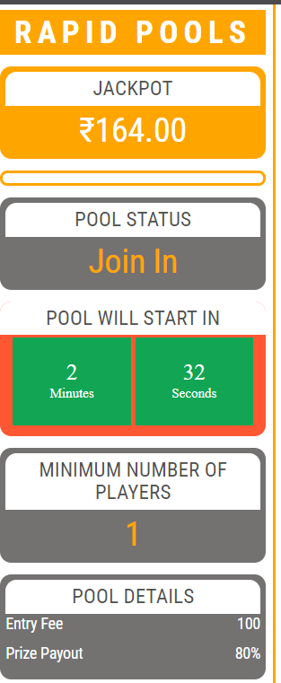
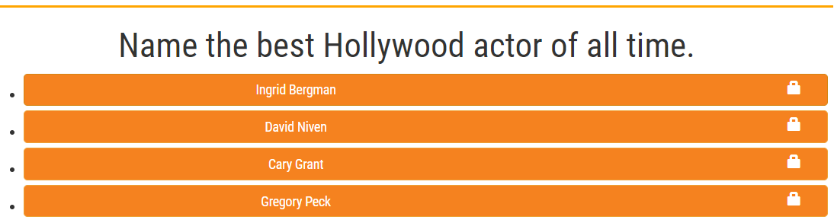
Virtual Hall Game Page
Game Information
Game Play Area
Players Joined
Chat Relay
Entry Fee Rs.
25
Click Here to enter this pool
Enter Chat
Loxley International Foundation
About Us
T & C
How to Play
Privacy Policy

Slide 8
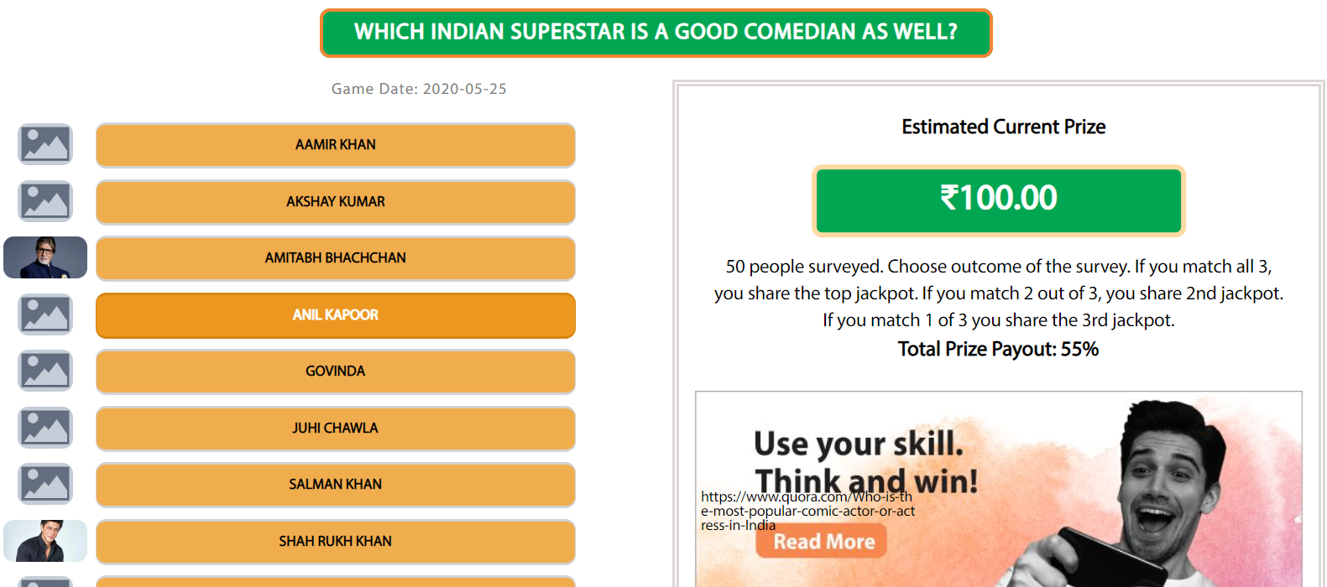
3rd Party Games – GIG POOLS
Entry Fee
Play Again
Exit
Loxley International Foundation
About Us
T & C
How to Play
Privacy Policy

Slide 9
Admin. Portal
Loxley International Foundation

Slide 10

Admin. Portal
Sign Up
Login
Game Information
Question
Game
Approve Games
Player account
Reports
Content Update
Configurations
Secure Section
Default to Level 1 – Normal game
Future
Level 2 to 7 – Badge of Honor games
Level 8 to 12 – Loyalty games
Level 13 to 20 – additional fee to play
Game Level
1 to 10
Add
Type of Game
Trivia
Add
Trivia
Survey
Jeopardy
Group
Movies
Add
Group Sports
Group 3 - Music
Type of game = Channel
Group = Category
Session = Event
Question = Element
Options = Sub-Element
Loxley International Foundation
Exit

Slide 11
Admin. Portal
Sign Up
Login
Game Information
Question
Game
Approve Games
Player account
Reports
Content Update
Configurations
Secure Section
Type of game
Question (200 characters)
Trivia
Predict Duration
Survey
Gap
Jeopardy
Correct
OPTIONS – 100 Characters
Difficulty Level
OPTION 1
Game Level
Voting Duration
1
OPTION 2
2
OPTION 3
3
OPTION 4
Each question created is now linked to Type of game, Game Level and Group
OPTION 5
Group
OPTION 6
Group Sports
OPTION 7
Group - Movies
OPTION 8
Group 3 - Music
OPTION 9
OPTION 10
Loxley International Foundation
Add
Edit
Del
Exit

Slide 12
Admin. Portal
Sign Up
Login
Game Information
Question
Game 1 of 2
Approve Games
Player account
Reports
Content Update
Configurations
Secure Section
Type of game
Session details
Trivia
Active Date/Time
Join Duration
Survey
List of Questions 1
List of Questions 2
List of Questions 3
List of Questions 4
List of Questions 5
List of Questions 6
Jeopardy
Game Level
1
List of Questions | Question Duration | Gap - question | Difficulty level - question | Remove
List of Questions 5 | 0:30 | 0:05 | 1
2
3
Group
Group Sports
Group - Movies
Group 3 - Music
Loxley International Foundation
Add
Next

Slide 13
Admin. Portal
Sign Up
Login
Game Information
Question
Game 2 0f 2
Approve Games
Player account
Reports
Content Update
Configurations
Secure Section
Name of the game
100 characters with special characters
Entry Fee
Can be zero and decimal
Prize Payout %
Can be up to 100%
Jackpot Seed
Can be zero
Minimum # of members
Default 1
Prize level | Description | % of the jackpot
1
2
3
4
5
6
Total | Must add to 100% | 0.0
Player Description
200 Char.
External URL
200 Char.
Load Game picture
Loxley International Foundation
Previous
Save as Draft
Send for approval
Cancel

Slide 14
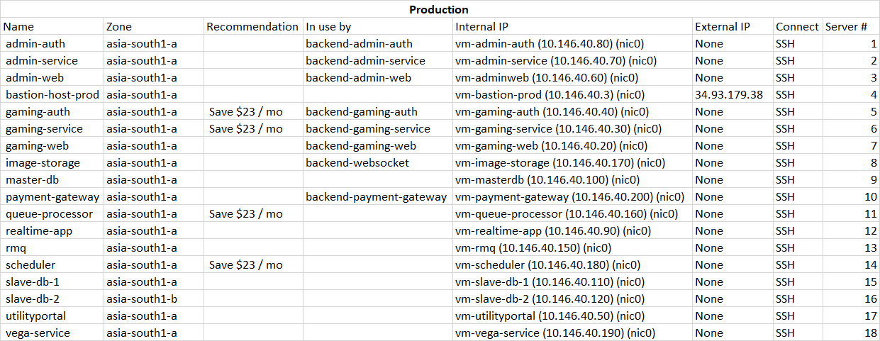
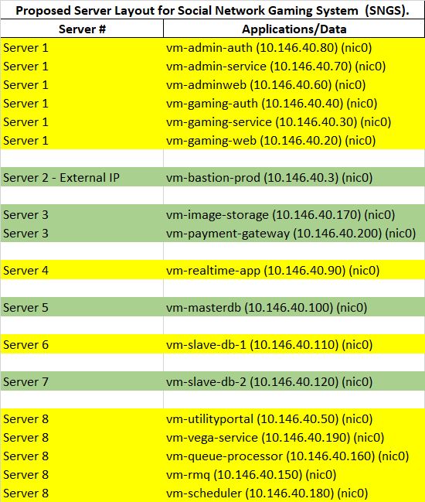
Loxley International Foundation

